Slide 1
The Indiana Center for Vascular Biology and Medicine
Michael P. Murphy, MD, FACS The Cryptic Masons Medical Research Foundation Professor in Vascular Biology Research Indiana University School of Medicine
Chair, Biotechnology and Surgical Sciences Study Section of the National Institutes of Health

Slide 2

Update for the Indiana Center for Vascular Biology and Medicine
2026

Slide 3
Active Research Programs
Critical Limb Threatening Ischemia
“Reverse” Vaccine to Prevent Aortic Aneurysms
3D Hand-Held Bioprinter to Treat Aortic Aneurysms
Defining the Epigenetic Events that Cause Aortic Aneurysms
Gene Therapy to Treat Ehlers-Danlos Syndrome

Slide 4
Accomplishments
Three new publications:
  Vertebral body mesenchymal stromal cells
  Induced Pluripotent Stem Cell Derived Mesenchymal Stromal Cells to Treat Chronic Limb Threatening Ischemia
  Immune Tolerance with Nanoparticle Delivery of Elastin Peptides in Aortic Aneurysm
Four grant applications
Dr. Steven Miller- Distinguished Scientist Award from the American Heart Association.
Dr. Leni Moldovan- Research Award , North American Vasclar Biology Organization

Slide 5
Stem Cell Therapy for Disease
Restricted to US Food and Drug Administration approved clinical trials.
Not readily available to the general patient population.

Slide 6
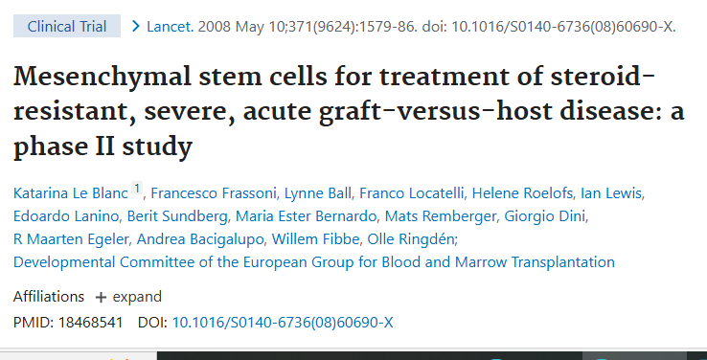

Slide 7
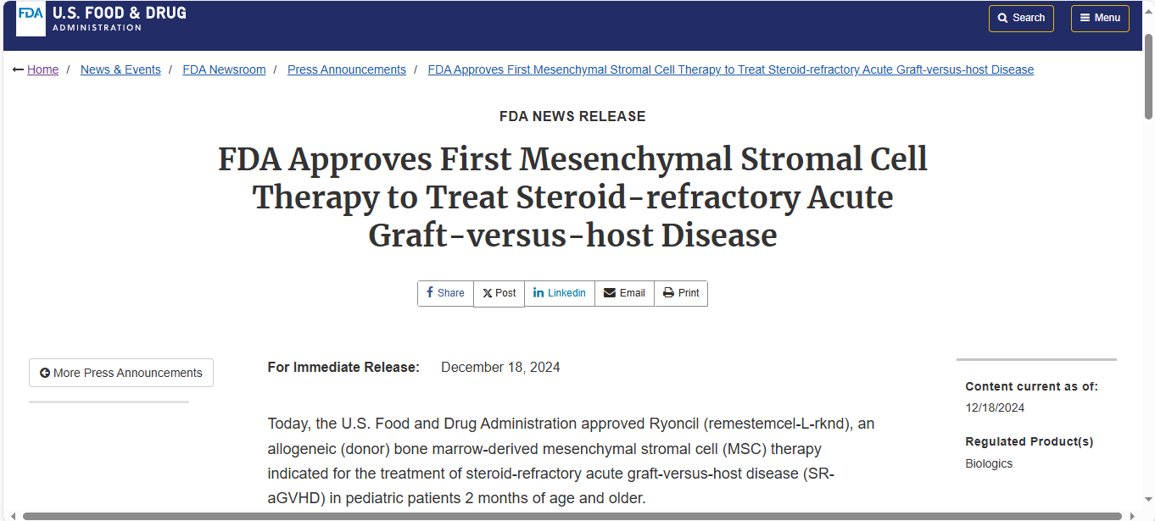

Slide 8
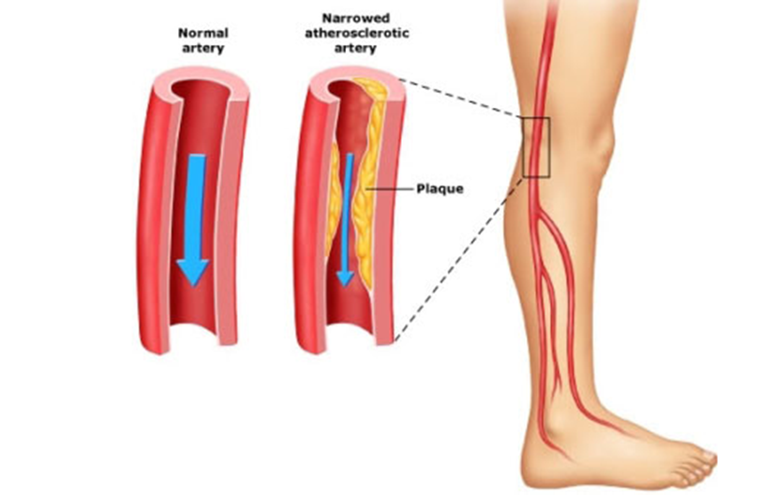
Peripheral Arterial Disease (PAD)
Normal
Artery
Diseased
Artery
PAD affects over 8 million people in the U.S.
3 stages of disease severity:
Asymptomatic: 33%
Claudication (pain with walking): 37%
Chronic Limb Threatening Ischemia: 5-7%
Plaque

Slide 9
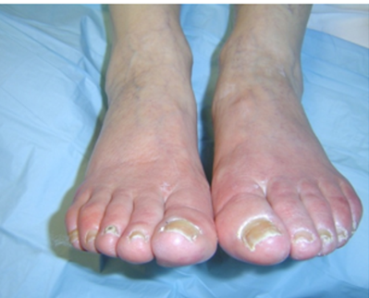
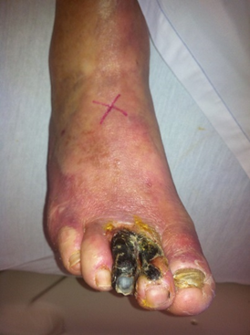
Chronic Limb Threatening Ischemia (CLTI)
Over 150,000 amputations each year in the US.
4-fold increase in diabetic patients
CLTI quality of life equivalent to terminal malignancy
Rest Pain
Tissue Loss

Slide 10
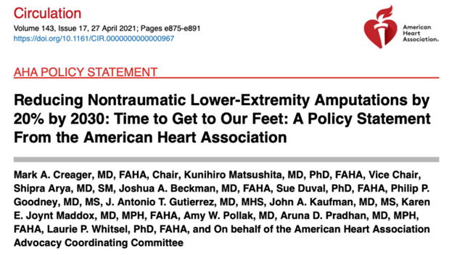

Slide 11
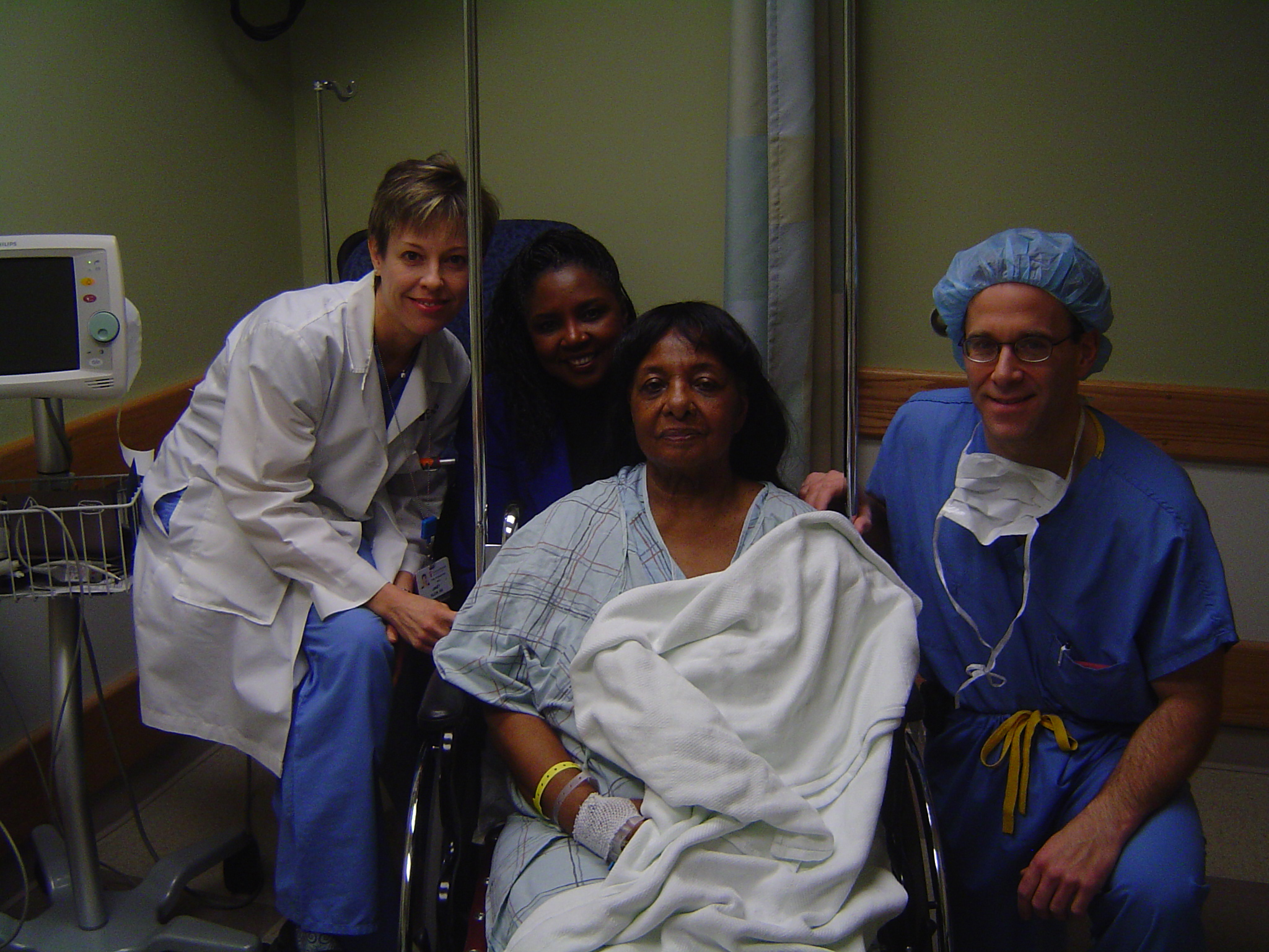
History of Autologous Bone Marrow Cell Therapy for
Stem cell research at Duke University…first US Food and Drug Administration trial for cell therapy for CLTI 2001
Duke provided funds for a pilot study

Slide 12
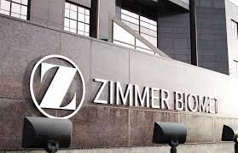
Biomet, Inc. Warsaw, Indiana and CMMRF

Slide 13

Intramuscular Administration of Autologous Bone Marrow Cells for Limb Preservation in Critical Limb Ischemia:
Results of the Phase II MOBILE* Trial
Michael P. Murphy, MD; Melina R. Kibbe; MD Charles Ross, MD; Rebecca L. Kelso, MD; Melhem J. Sharafuddin, MD; Edith Zeng, MD; Omaida Velazquez, MD; John Laird, MD and the MOBILE Trial Working Group
* (MarrOwStim Treatment of LimB IschemIa in Subjects With Severe Peripheral ArteriaL DiseasE)

Slide 14
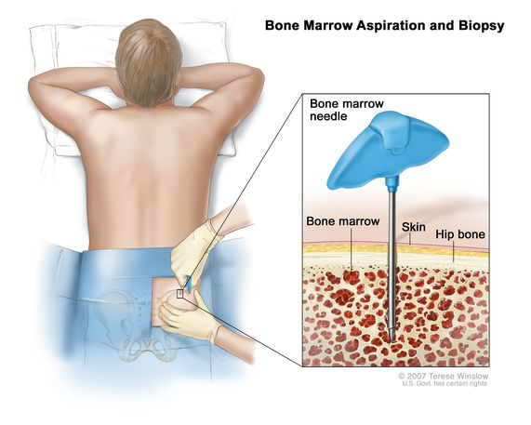
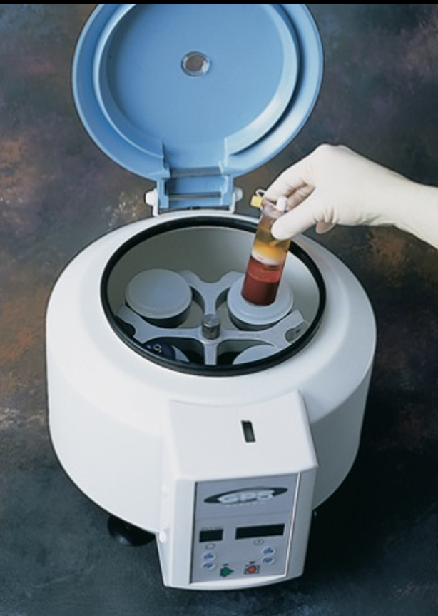
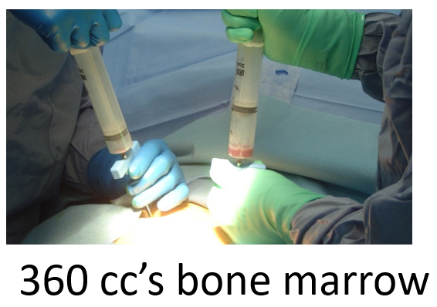
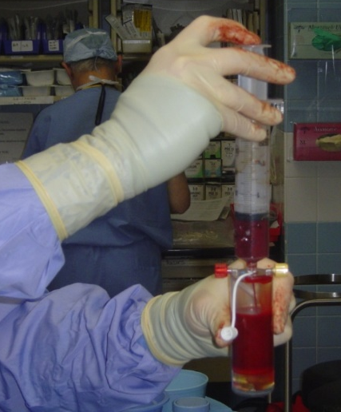
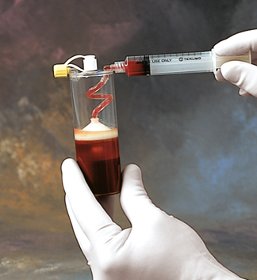
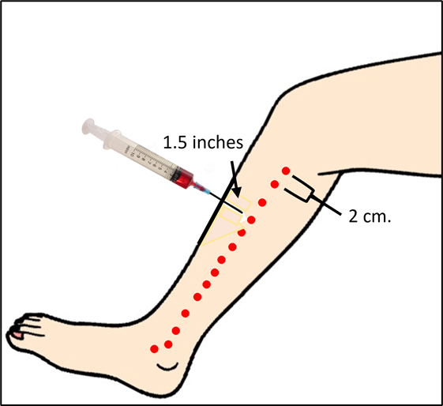
0.75 cc’s of cBMA is injected IM 1.5 inches deep at 35-40 sites in the index limb.

Slide 15


Slide 16


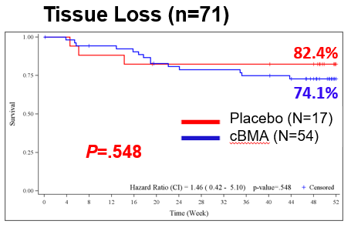
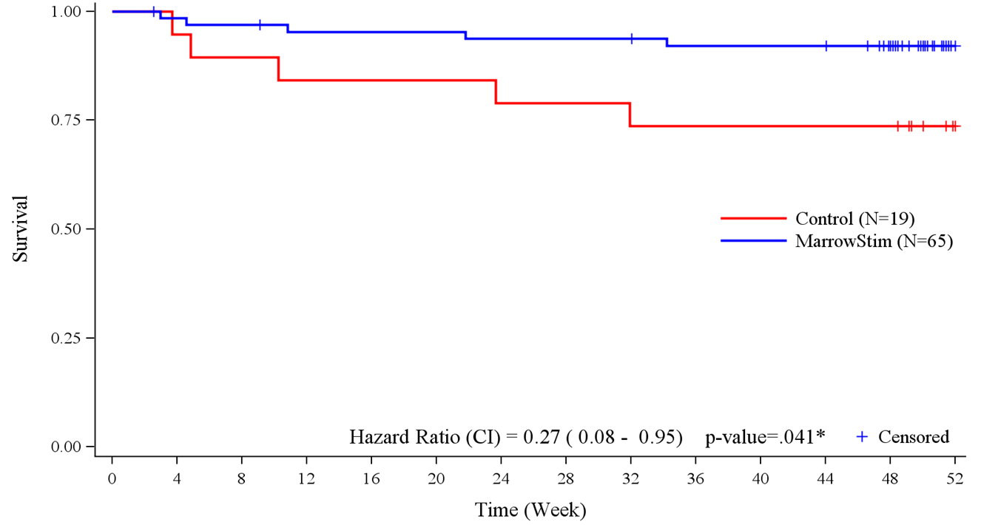

Freedom from Amputation at 52 weeks:
Rest Pain vs. Tissue Loss
Rest Pain (n=84)
92.3%
73.7%
Placebo (N=19)
cBMA (N=65)
P=.041

Slide 17
Claudication…pain with walking
Disabling. Limits the ability to work or enjoyable activities…walking with family or golf
Current recommendations from the American Heart Association and the Society for Vascular Surgery is NO SURGICAL OR ENDOVASCULAR INTERVENTION
We make things worse !!!! Risk factor modification is the recommendation

Slide 18
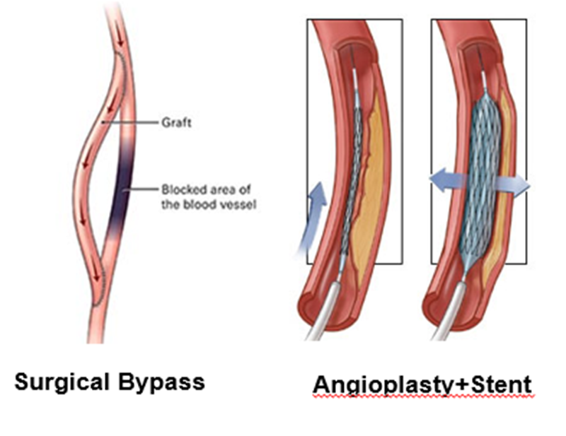
Science is Real….Makes things worse

Slide 19
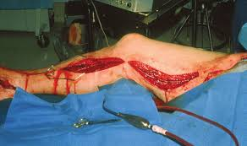

Slide 20
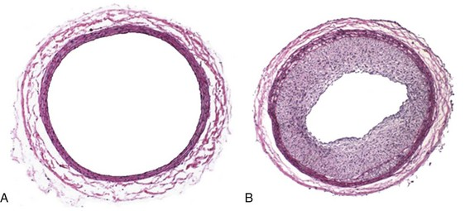
Neointimal Hyperplasia

Slide 21
Fast Forward….
Zimmer-Biomet received approval for use of the Marrow Stim device ™ for all causes of PAD in Europe
The ICVBM has been meeting with Zimmer-Biomet to obtain US FDA approval for clinical use of MarrowStim in PAD patients.
Target population: Claudication and Rest Pain

Slide 22

Finish Line

